Slide 1
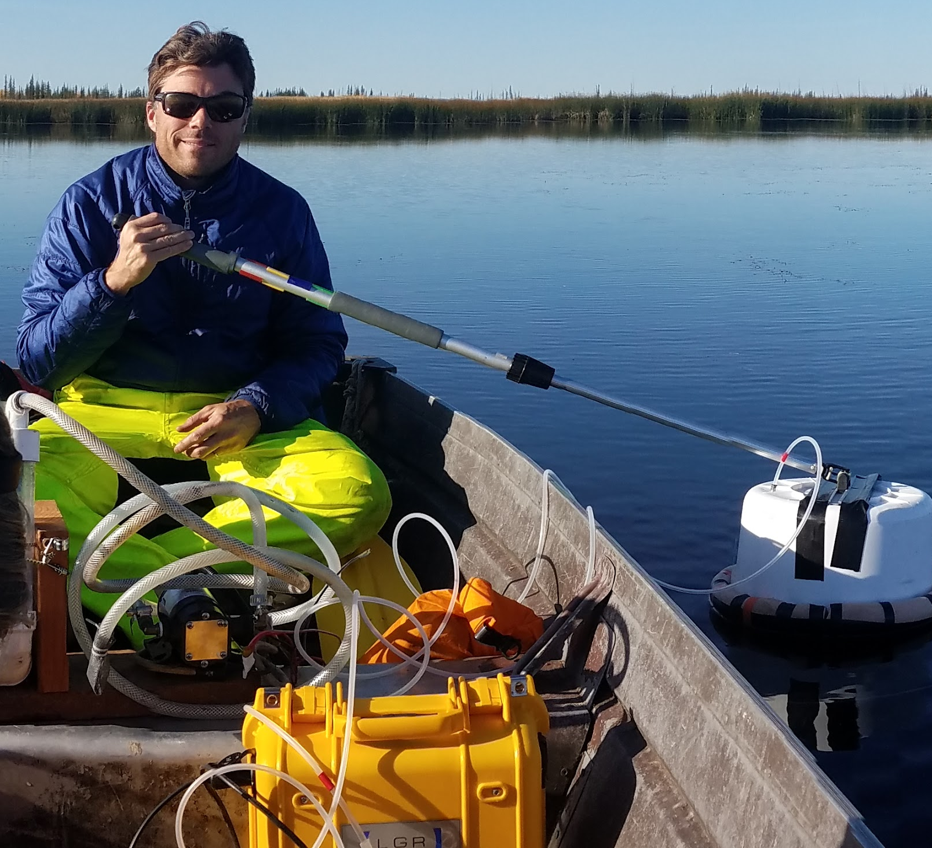

Integrating ABoVE airborne datasets and field campaigns to identify hotspots of surface water inundation and carbon flux across Arctic-Boreal ecosystems
PI: David Butman, University of Washington, Seattle WA;
Co Is: Tamlin Pavelsky University of North Carolina, Chapel Hill, NC;
Laurence C. Smith University of California, Los Angeles, CA;
Rob Spencer, Florida State University, Tallahassee, FL;
Robert Striegl, U.S. Geological Survey, Boulder, CO;
Kimberly Wickland, U.S. Geological Survey, Boulder, CO

Slide 2
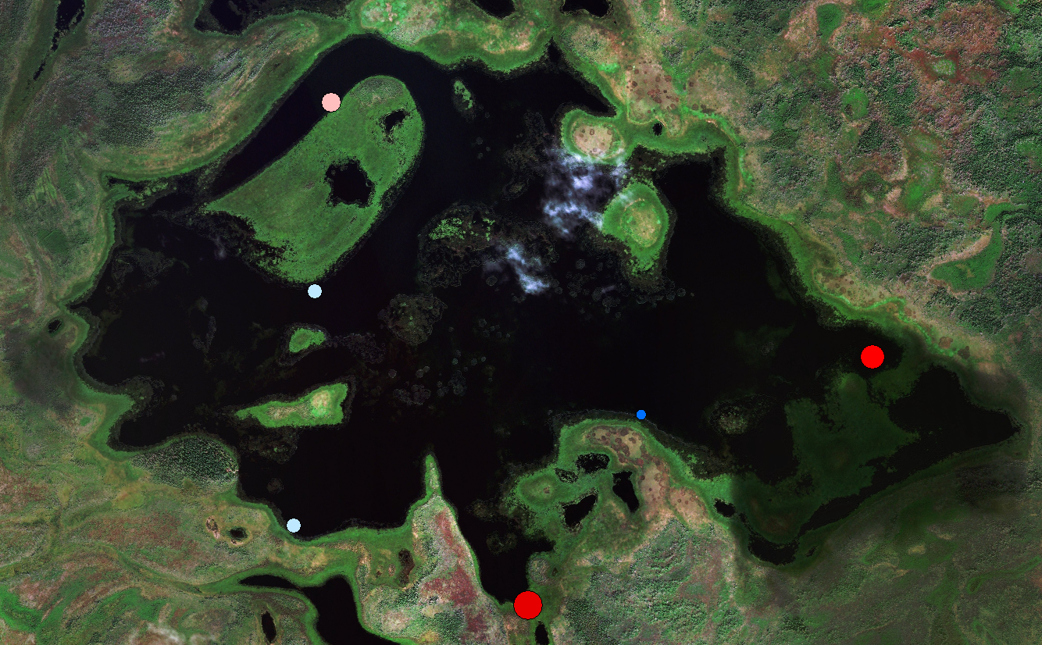
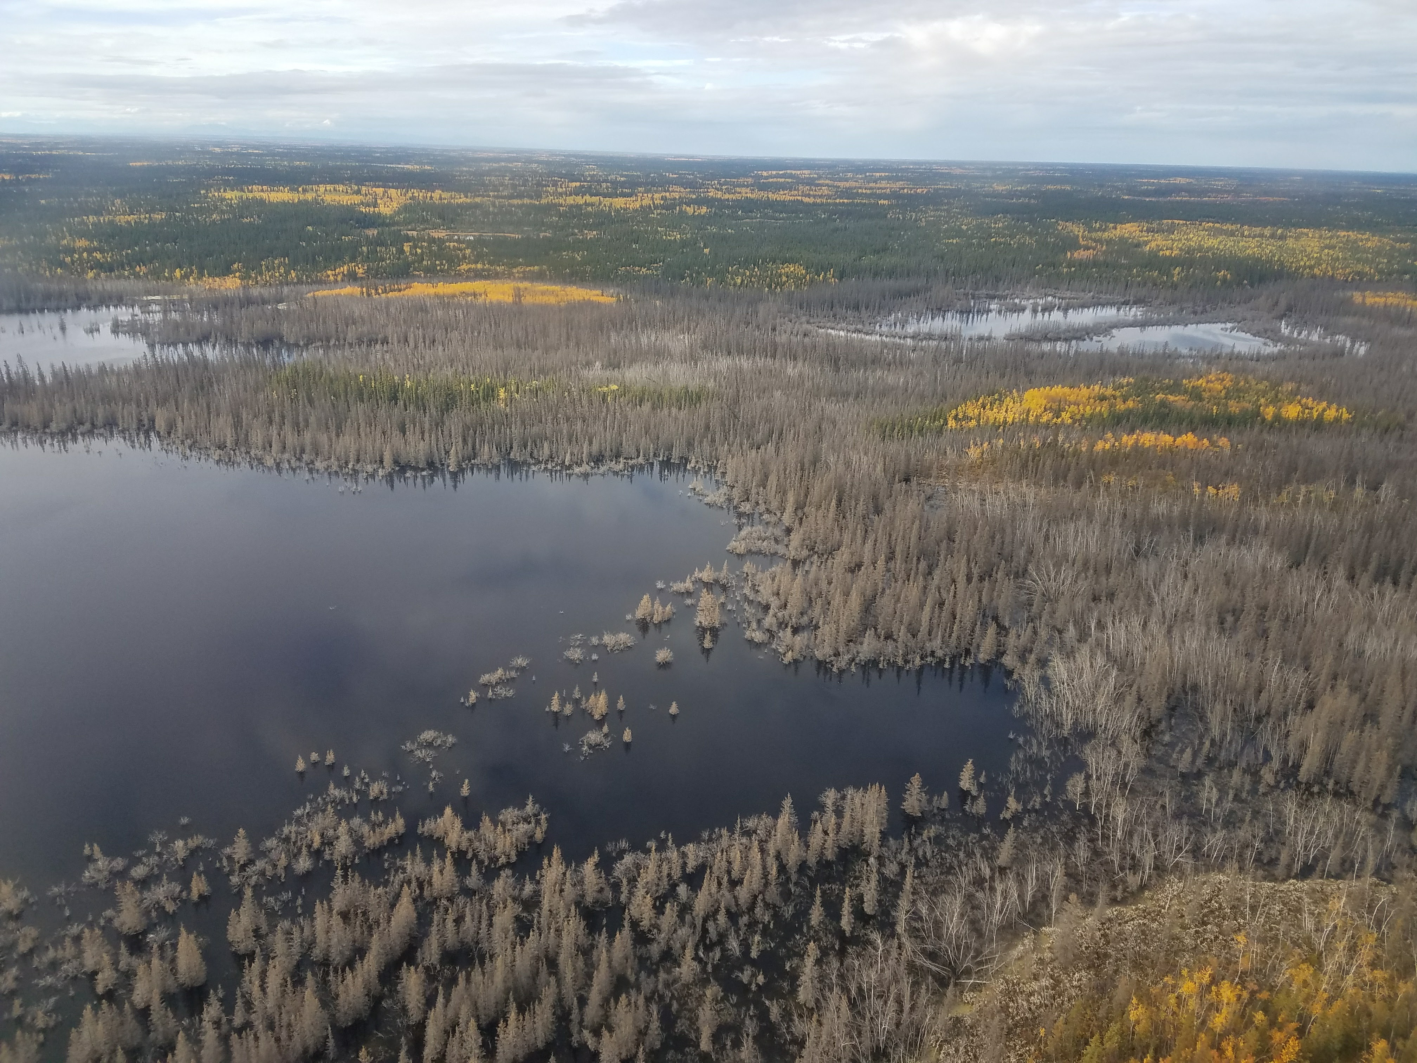
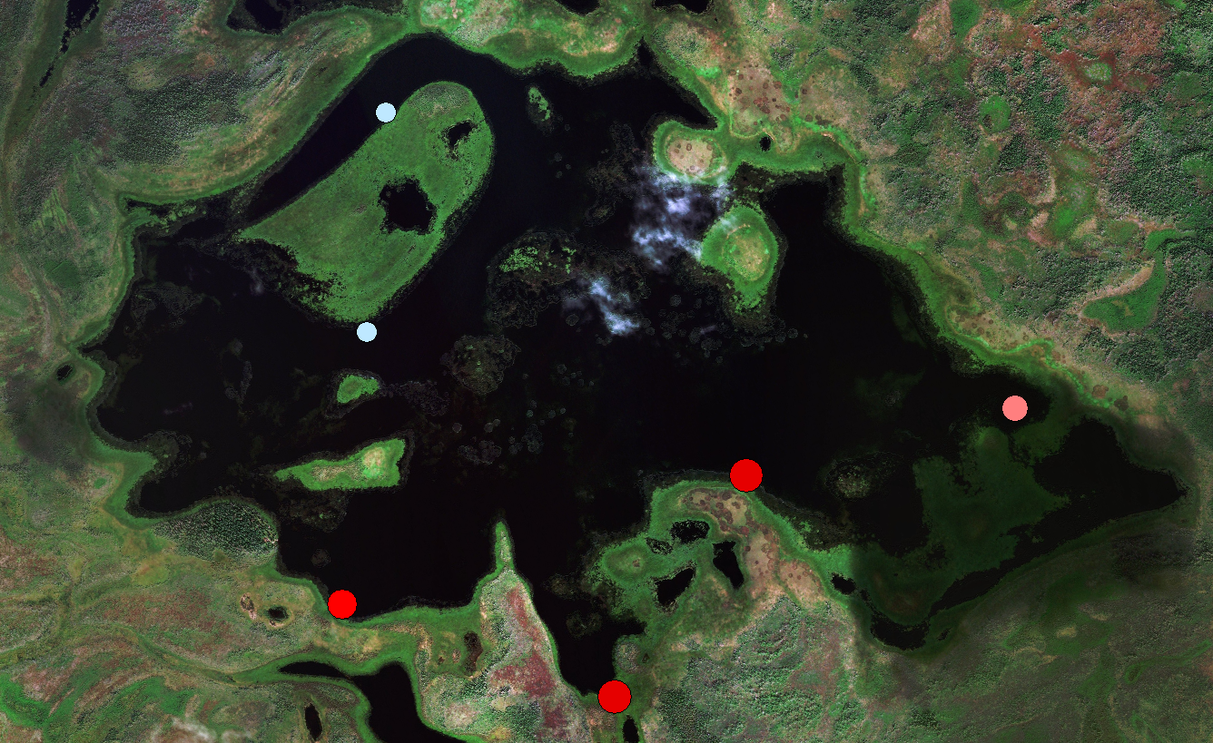
Science Objectives (Location Matters for C-Flux)
76 CO₂ ppm 1486
12-Mile Lake in the Yukon Flats National Wildlife Refuge recently inundated forested land from ice jams on the Yukon River (D. Butman)
134 CH₄ ppm 428
Canvasback Lake CO₂ and CH₄ Concentrations summer 2018
Tier 2 Science Questions: This proposal addresses questions 3.4, 3.5 and 3.6 focusing on the intersection of changing hydrology, species composition, and carbon cycling across both terrestrial and aquatic domains.

Slide 3
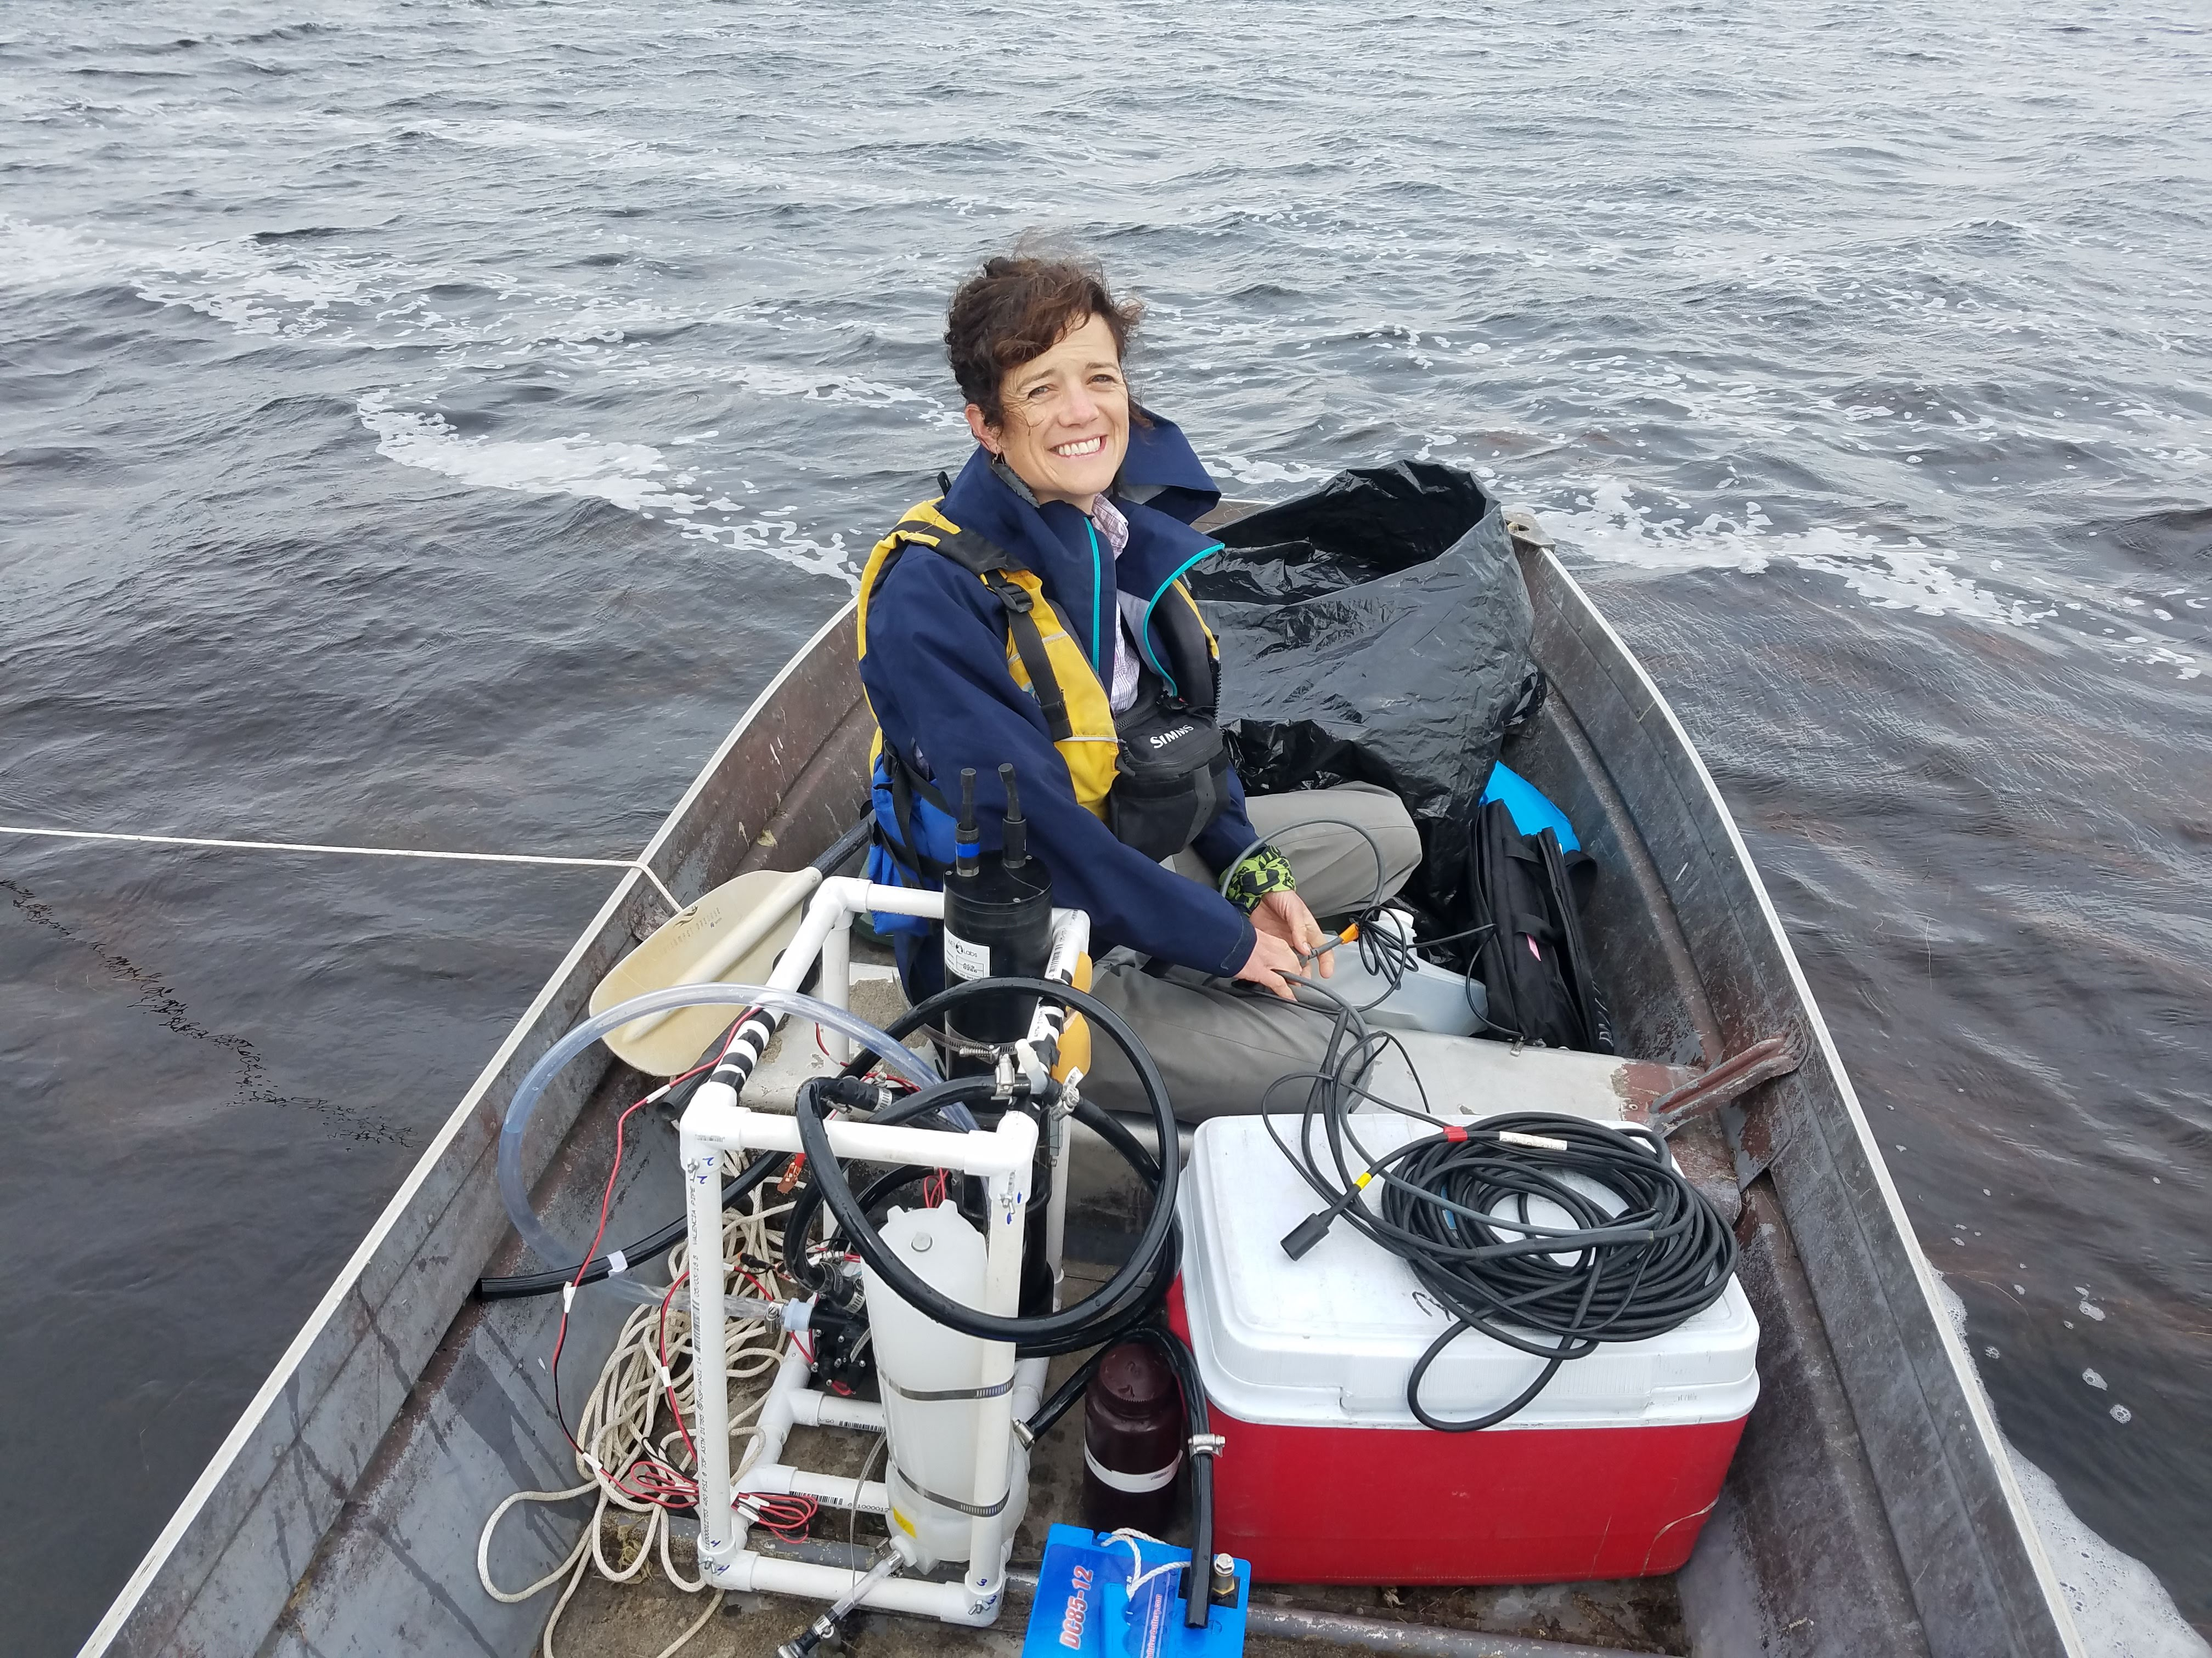
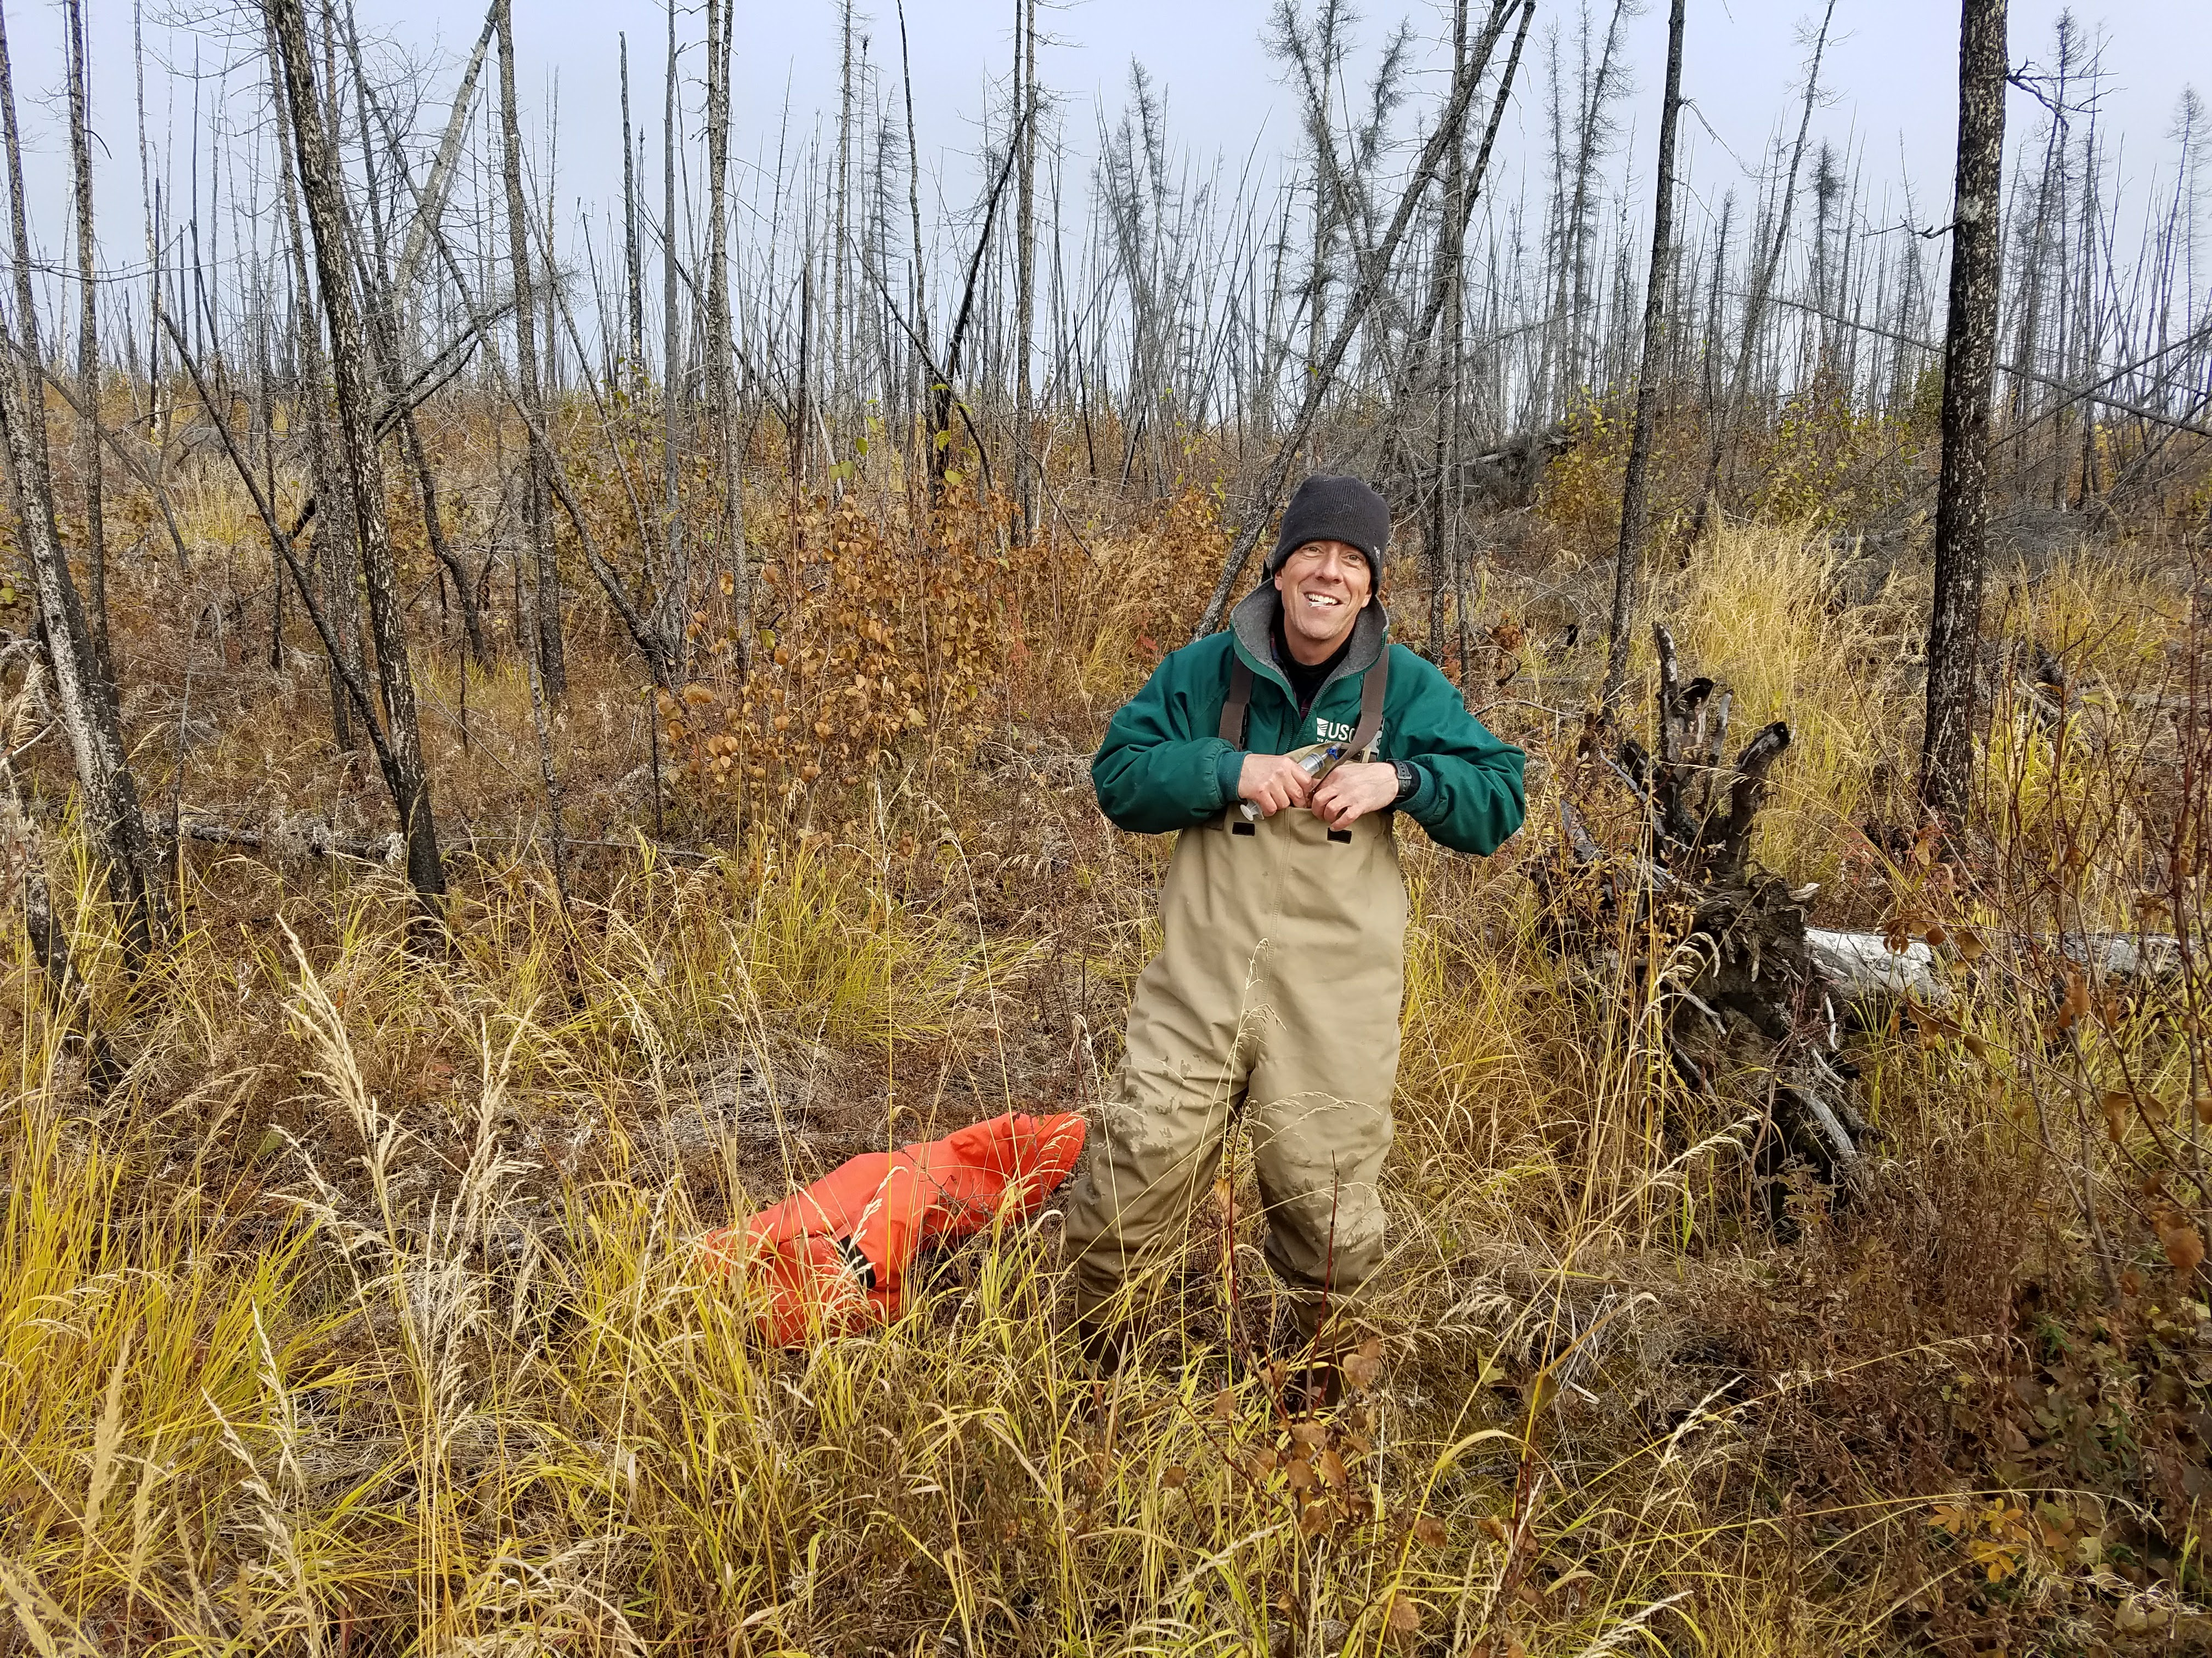
Science Objectives (detail)
O1: Utilize UAVSAR, AirMOSS, AirSWOT, LVIS, and AVIRIS-NG to identify inundation extent and water surface elevation across northern latitude lake ecosystems.
O2: Identify and measure the connectivity of terrestrial ecosystems to lake ecosystems with changing inundation extent and quantify the signature and concentrations of terrestrial and aquatic carbon sources.
O3: Quantify the fluxes of CO₂ and CH₄ to the atmosphere across a gradient from unsaturated to saturated soils and vegetation.
C. Kuhn (UW) Measuring reflectance YFNWR
M. Dornblaser (USGS) Finding sensors at Boot Lake YFNWR

Slide 4
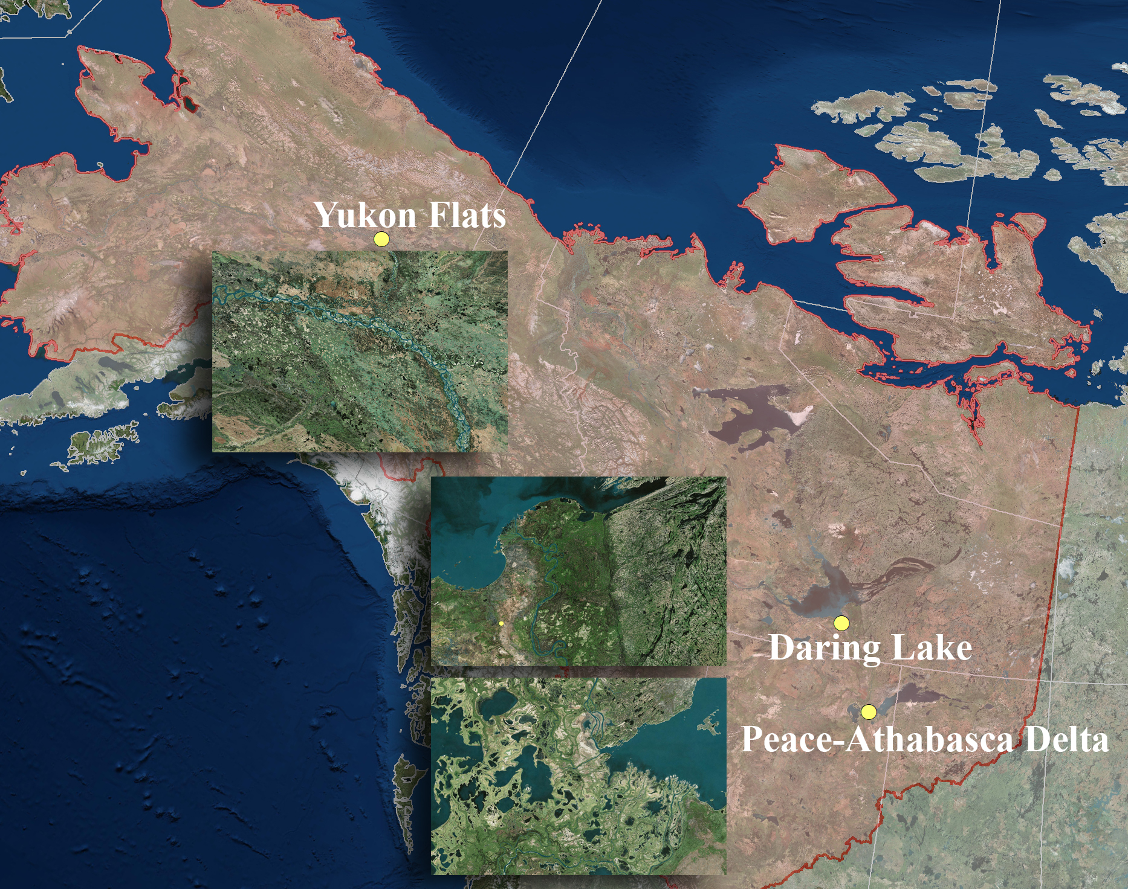
Site Locations for ABoVE2
Notes:
Airborne and field data collections are designed to vary from low terrestrial-aquatic connectivity through the hydrologic systems (YFNWR) to high hydrologic connectivity (Peace Athabasca Delta)
Sporadic permafrost exists in the Yukon Flats. The Peace Athabasca Delta has extreme patterns of inundation and evaporation each year. The Yellowknife – Daring Lake system sits within the Canadian shield, with shallow surface and ground water flow paths

Slide 5
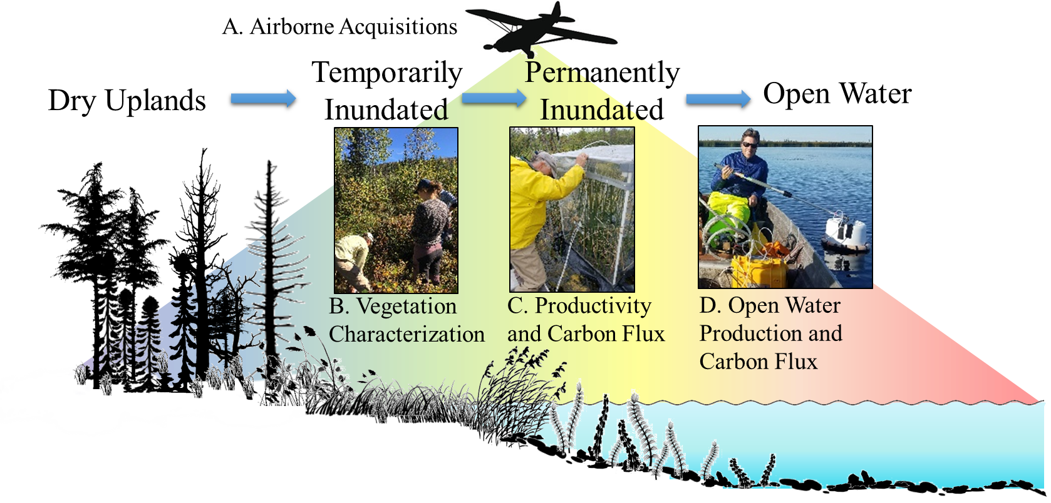
Field Campaign Design (U.S.G.S. Support)
Notes:
A. LVIS, AirSWOT and AVIRIS-NG will be utilized to identify vegetation composition and structure for mapping, as well as water elevation and inundation extent.
B. Field based site validation will be conducted summer 2019, 2020 for species composition,
C. Field measurements across the domain of inundations of carbon concentration in water, chemical composition of organic matter, as well as direct carbon flux summer 2019, 2020,
D. Open water carbon measurements of chemical composition, ecosystem productivity, and carbon flux. Integration of carbon cycling and AAC data will be done across each of the 4 defined zones.

Slide 6
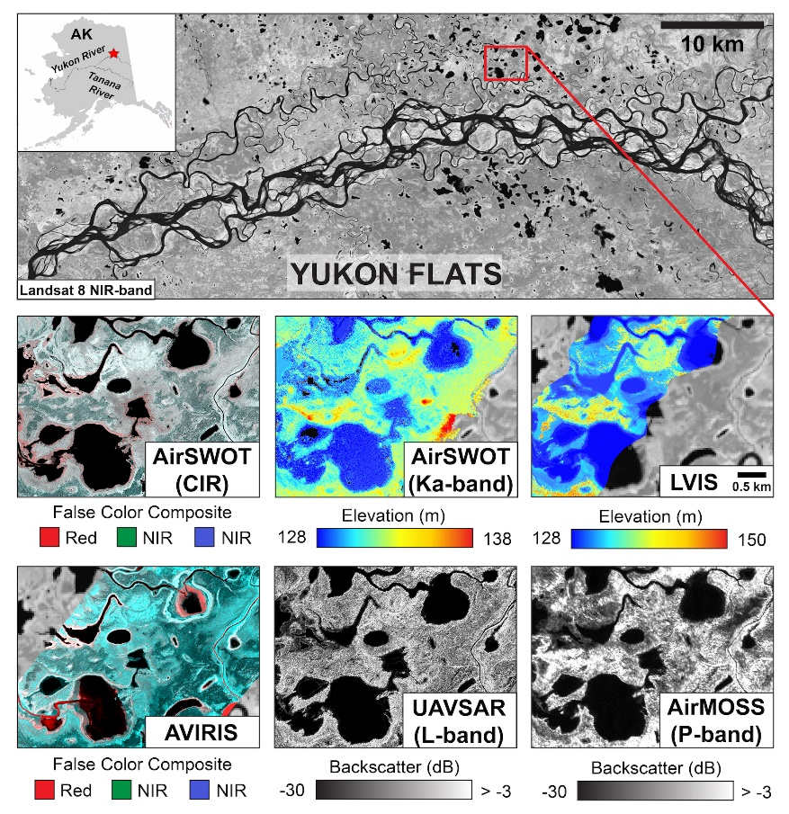
Airborne Remote Sensing (2017-2019/20 campaigns)
c.
Products will include:
  Maps of inundation extent and inundated vegetation
  Water Elevation
  Vegetation structure and class from open water to upland
  Scaled estimates of C-Flux across inundated zones
e.
f.
Datasets to be used for inundation extent – vegetation class and structure, and mapping of regions for carbon flux. The Yukon Flats are depicted here.

Slide 7
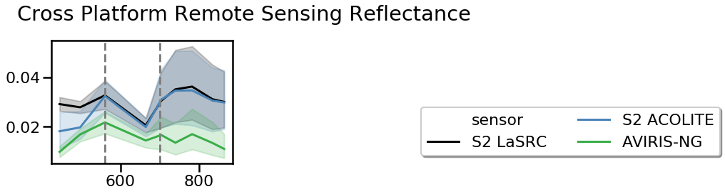
Airborne / Satellite optical properties and scaling (NESSF) C. Kuhn
type 2 major axis regression: y = 567.6x – 2.53; r² = 0.71; p = 4.58 x 10⁻⁶
A.
B.
Rs
μm
A. Correlation between Gross Primary Production derived from estimate of ecosystem metabolism from ¹⁸O, and the OLI Band 3( Green). Points colored by depth. B. Reflectance comparisons for arctic lakes across field – Airborne – Sentinel-2 scales (Kuhn et al. in prep).

Slide 8
Stakeholder Engagement and Collaboration
Collaborators:
  Mark Bertram, U.S. Fish and Wildlife Service, Fairbanks, AK
  Dr. Daniel Peters, Environment & Climate Change Canada
  Mr. Bruce Hanna, Government of the NWT
  Dr. Sherry Schiff, University of Waterloo
  Dr. Charles Miller, NASA J.P.L
  Dr. Clayton Elder, NASA J.P.L
  Dr. Colin Gleason, University of Massachusetts, Amherst.
Direct Partnership with the Northwest Boreal Land Conservation Co-OP through USGS
Provide products identified as a direct need by the Government of Northwest Territories
Maintain and develop strong partnerships with Environmental & Climate Change Canada for matched field efforts into the future.
New collaboration with Dr. Sherry Schiff through a pairing of the ABoVE2 proposal and an NSERC proposal focused on C dynamics in the Yellowknife and Daring Lake region

